Slide 1

SAC REPORT
in hGF-1 Cells

Slide 2
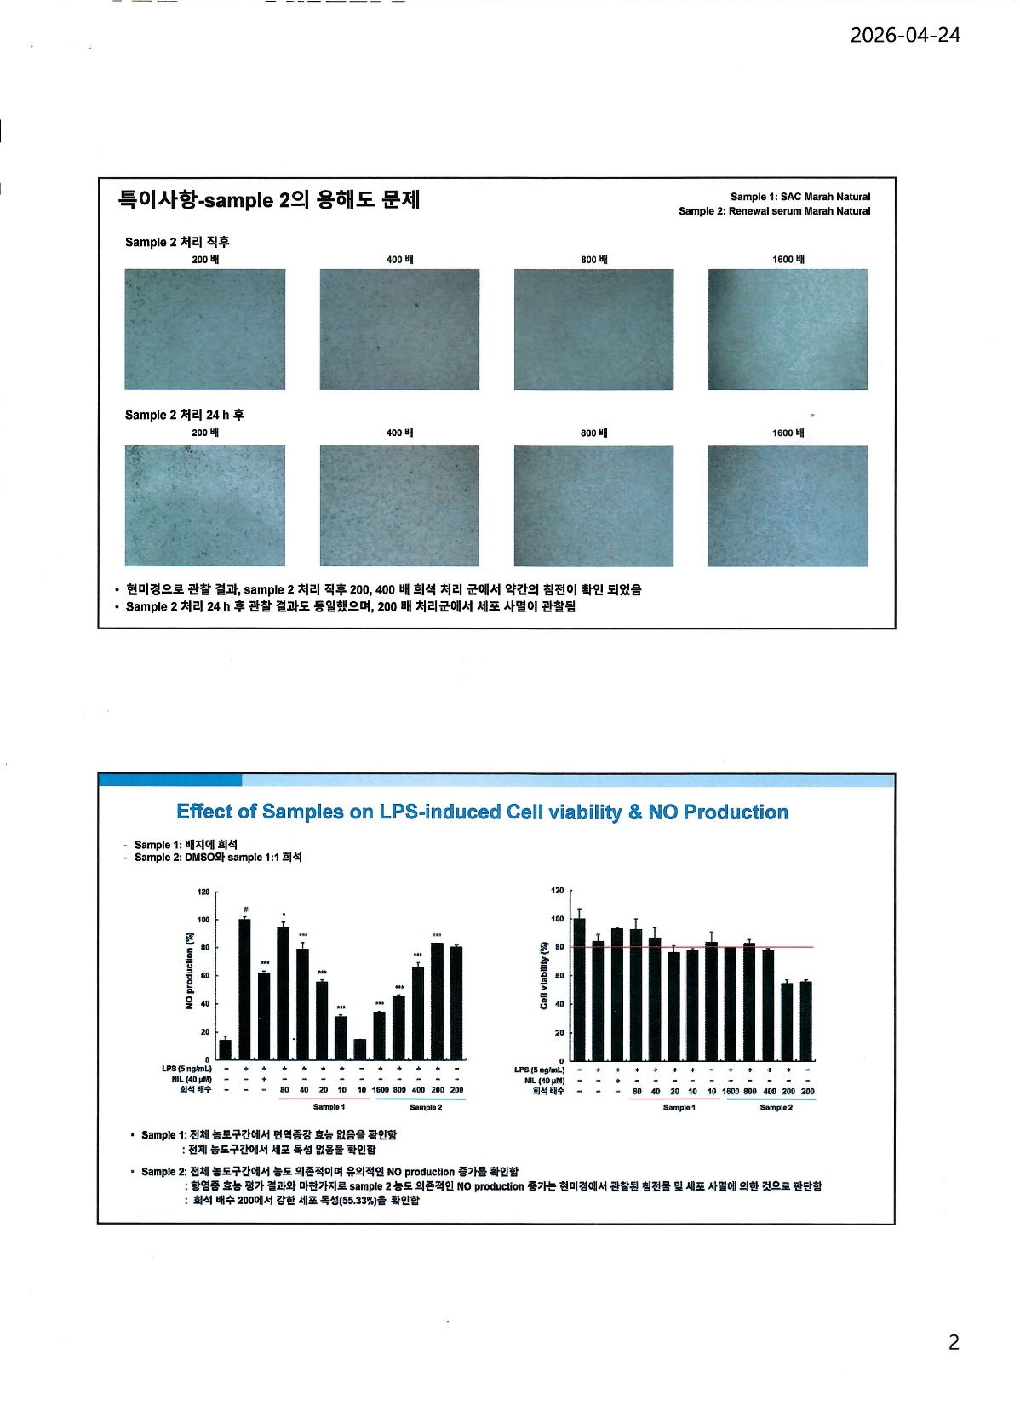
Effect of Sac on LPS-induced Cell viability & No Production
No immunostimulatory effect was observed across the entire concentration range.
No cytotoxicity was observed across the entire concentration range.
Dilution Rate
Dilution Rate
Diluted in culture medium

Slide 3
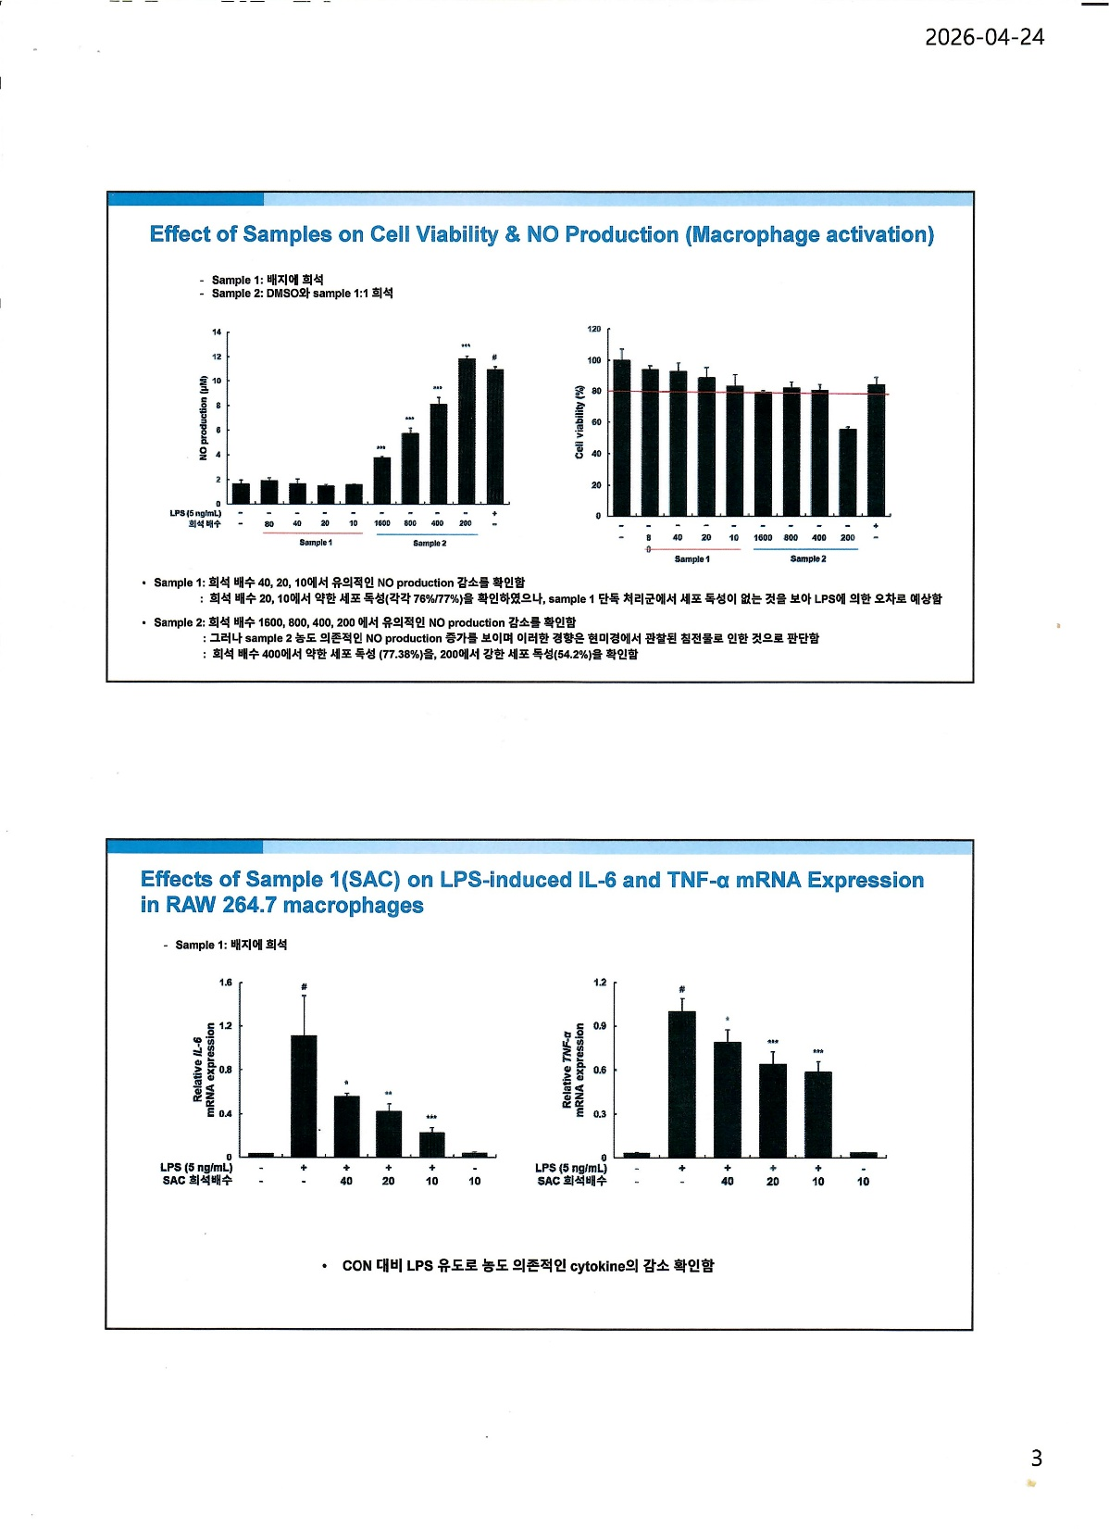
Effect of Sac on Cell Viability & No Production (Macrophage activation)
A significant decrease in NO production was observed at 40×, 20×, and 10× dilutions.
Weak cytotoxicity was observed at 20× and 10× dilutions (76% and 77%, respectively);
however, since no cytotoxicity was observed in the Sample 1–only
treatment group, this is presumed to be due to variability associated with LPS.
Dilution Rate
Diluted in culture medium

Slide 4
Effect of SAC on LPS-induced IL-6 TNF-α mRNA Expression
in RAW 254.7 macrophages
A concentration-dependent decrease in cytokine levels was observed
following LPS induction compared to the CON
Dilution Rate
Dilution Rate
Diluted in culture medium

Slide 5
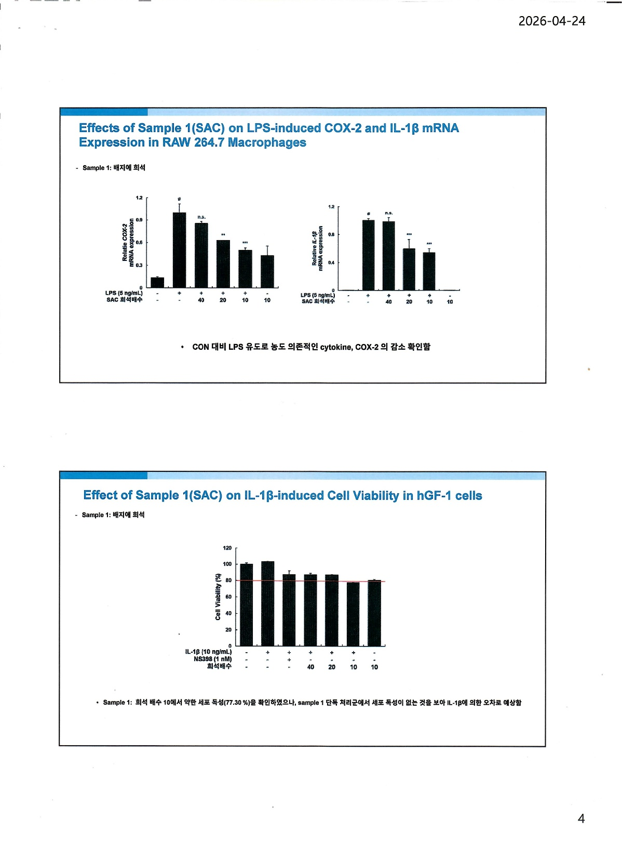
Effect of SAC on LPS-induced COX-2 and IL-1β mRNA Expression in RAW 264.7 Macrophages
A concentration-dependent decrease in cytokine levels and COX-2 expression
was observed following LPS induction compared to the CON
Dilution Rate
Dilution Rate
Diluted in culture medium

Slide 6
Effect of SAC on IL-1β-induced Cell Viability in hGF-1 cells
Weak cytotoxicity was observed at a 10× dilution (77.30%);
however, since no cytotoxicity was observed in the Sample 1–only treatment group,
this is presumed to be due to variability associated with IL-1β.
Dilution Rate
Diluted in culture medium

Slide 7
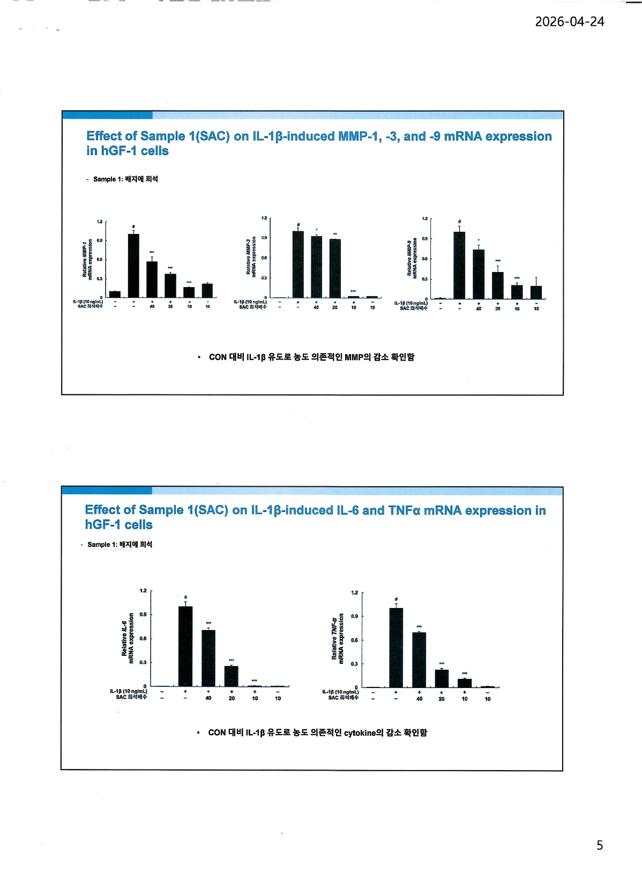
Effect of SAC on IL-1β-induced MMP-1, -3, and -9
mRNA Expression in hGF-1 Cells
A concentration-dependent decrease in MMP levels was observed
following IL-1β induction compared to the CON
Dilution Rate
Dilution Rate
Dilution Rate
Diluted in culture medium

Slide 8
Effect of SAC on IL-1β-induced IL-6 and TNFα mRNA Expression in hGF-1 Cells
A concentration-dependent decrease in cytokine levels was observed
following IL-1β induction compared to the CON
Dilution Rate
Dilution Rate
Diluted in culture medium

Slide 9
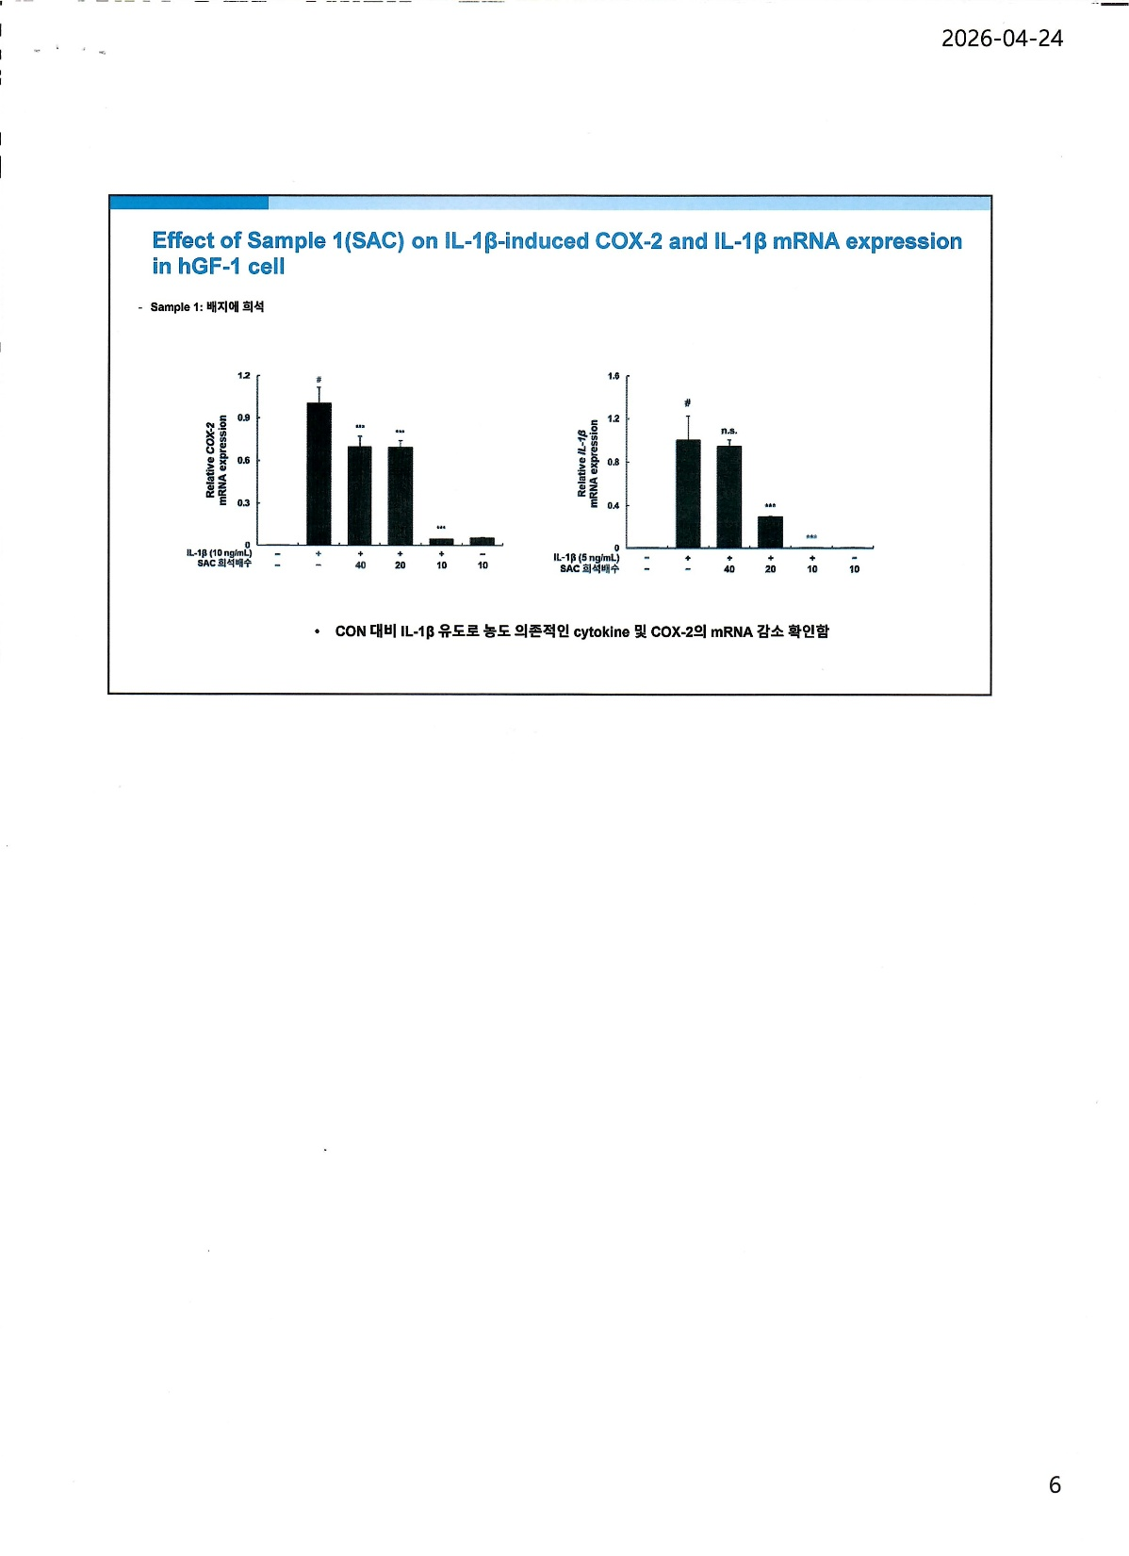
Effect of SAC on IL-1β-induced COX-2
and IL-1β mRNA Expression in hGF-1 Cell
A concentration-dependent decrease in cytokine and COX-2 mRNA expression was observed
following IL-1β induction compared to the CON
Dilution Rate
Dilution Rate
Diluted in culture medium

