Slide 1

SAC REPORT
Department of Pharmaceutical
Biochemistry
Kyung Hee University
Kyung-Tae Lee

Slide 2
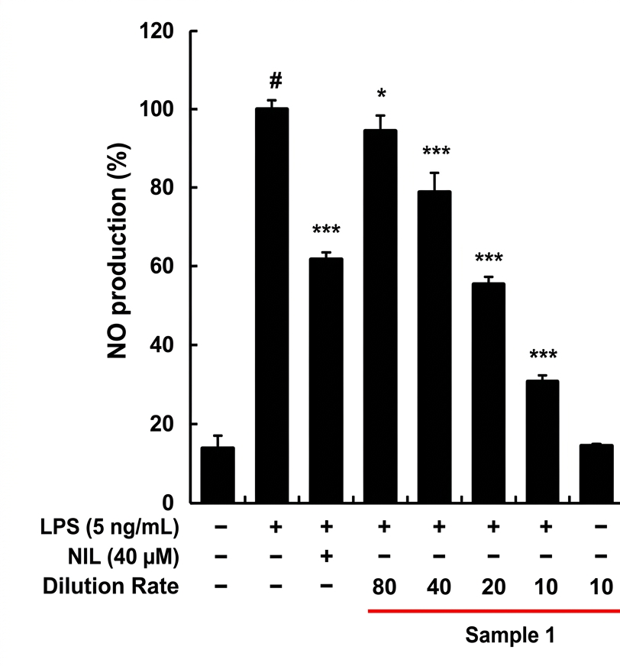
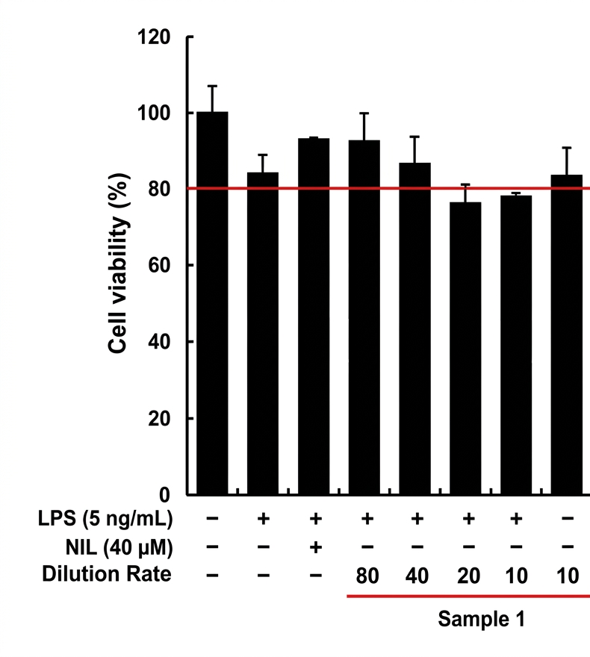
Effect of Sac on LPS-induced Cell viability & No Production
Diluted in culture medium
No immunostimulatory effect was observed across the entire concentration range.
No cytotoxicity was observed across the entire concentration range.

Slide 3
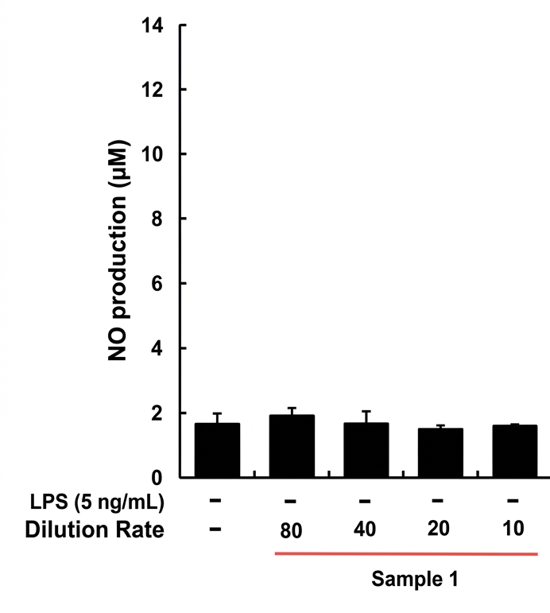
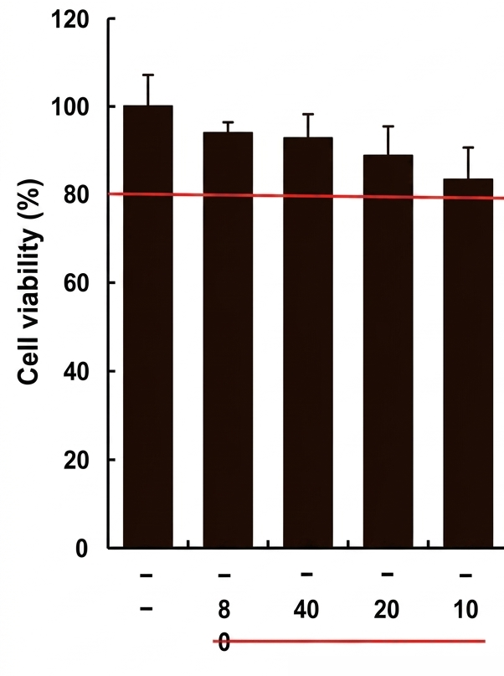
Effect of Sac on Cell Viability & No Production (Macrophage activation)
Diluted in culture medium
A significant decrease in NO production was observed at 40×, 20×, and 10× dilutions.
Weak cytotoxicity was observed at 20× and 10× dilutions (76% and 77%, respectively); however, since no cytotoxicity was observed in the Sample 1–only treatment group, this is presumed to be due to variability associated with LPS.

Slide 4
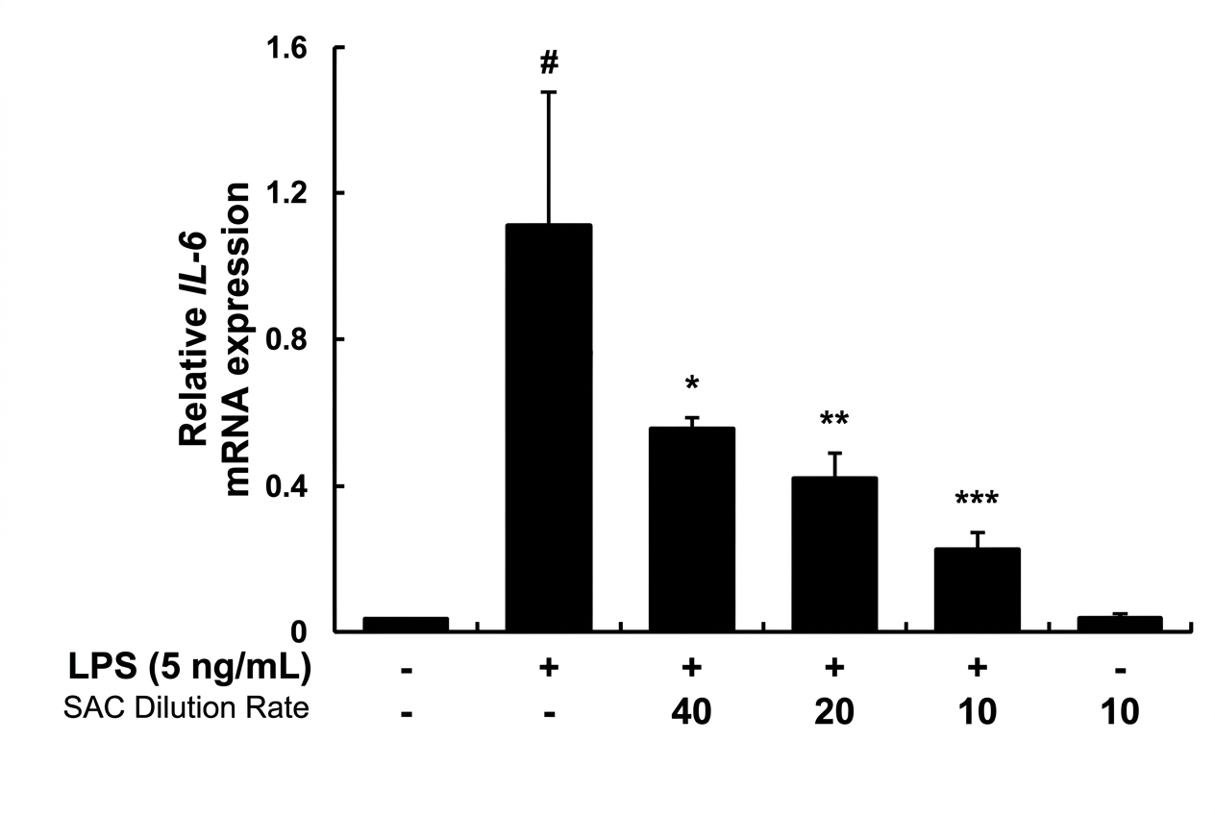
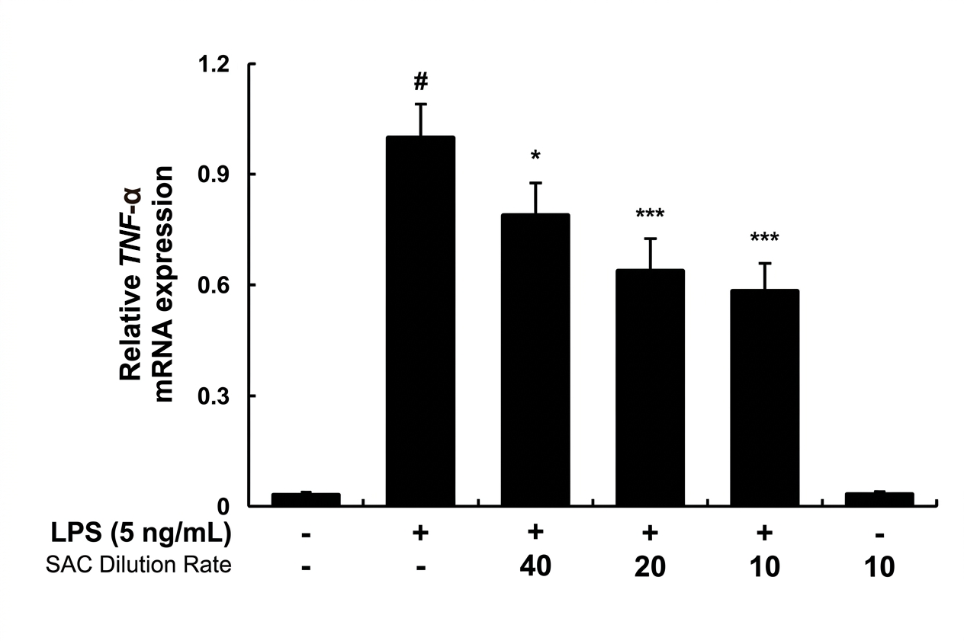
Effect of SAC on LPS-induced IL-6 TNF-α mRNA Expression
in RAW 254.7 macrophages
Diluted in culture medium
A concentration-dependent decrease in cytokine levels was observed following LPS induction compared to the CON

Slide 5
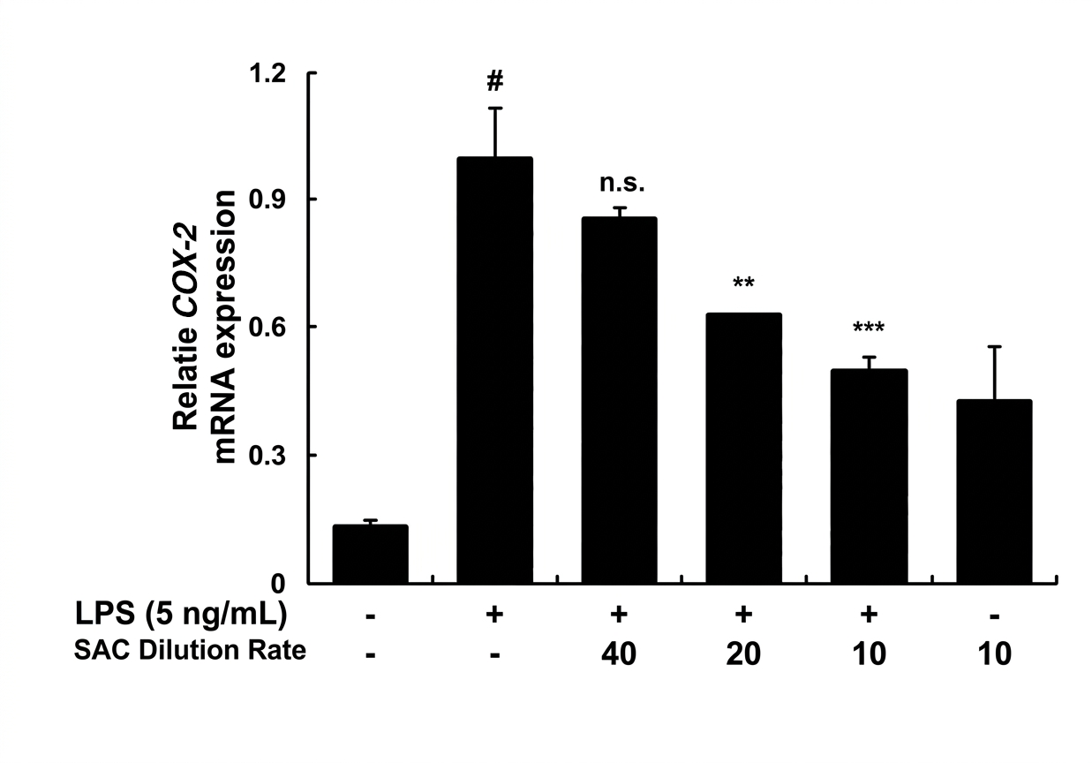
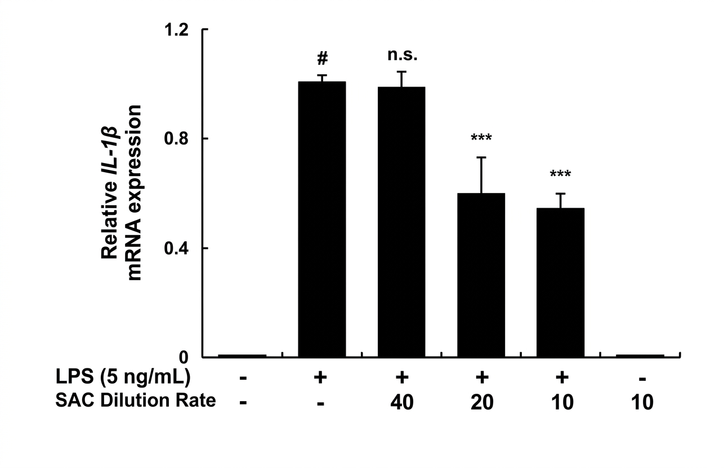
Effect of SAC on LPS-induced COX-2 and IL-1β mRNA Expression in RAW 264.7 Macrophages
Diluted in culture medium
A concentration-dependent decrease in cytokine levels and COX-2 expression
was observed following LPS induction compared to the CON

Slide 6
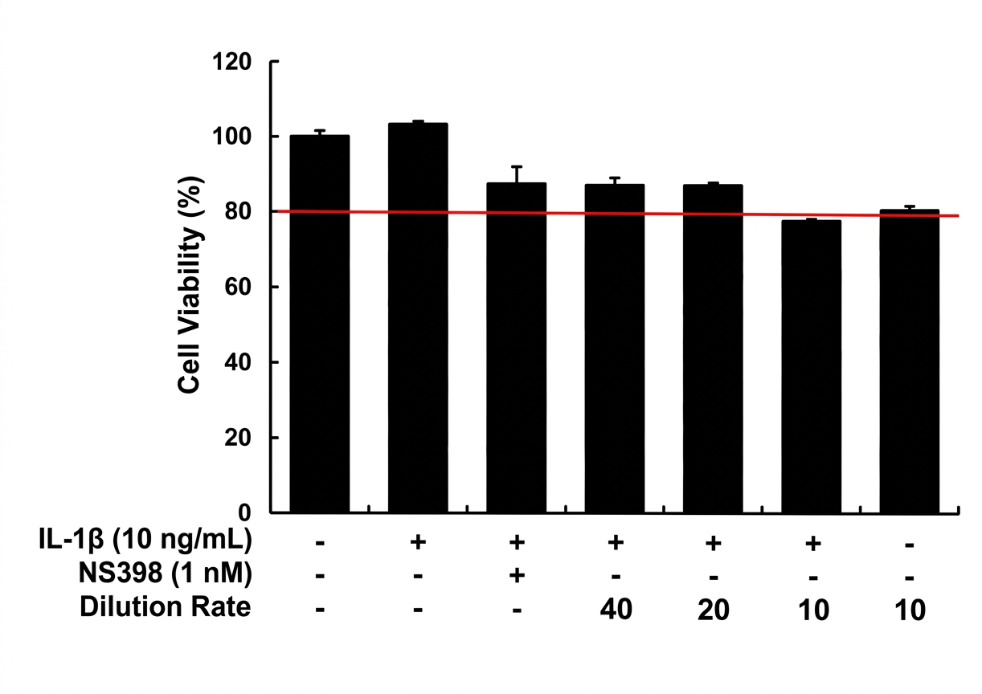
Effect of SAC on IL-1β-induced Cell Viability in hGF-1 cells
Diluted in culture medium
Weak cytotoxicity was observed at a 10× dilution (77.30%); however, since no cytotoxicity was observed in the Sample 1–only treatment group, this is presumed to be due to variability associated with IL-1β.

Slide 7
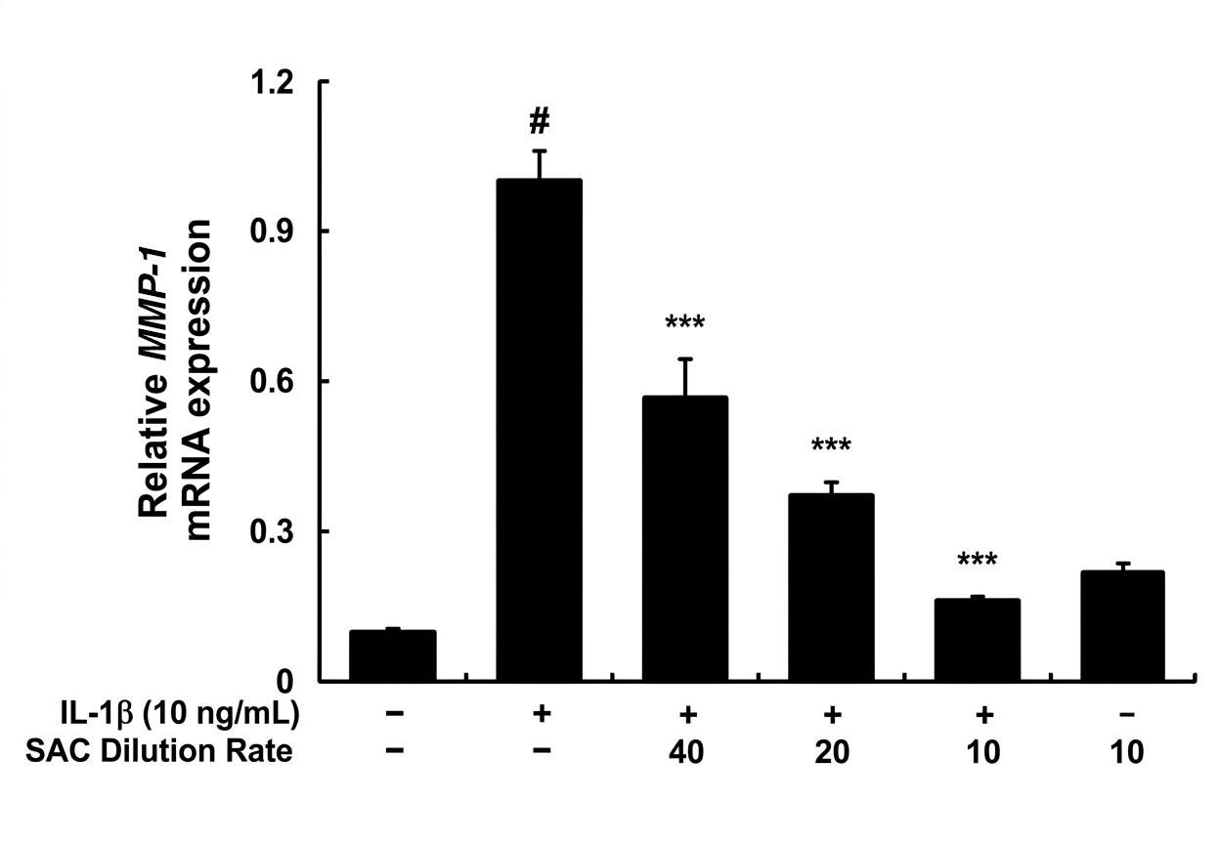
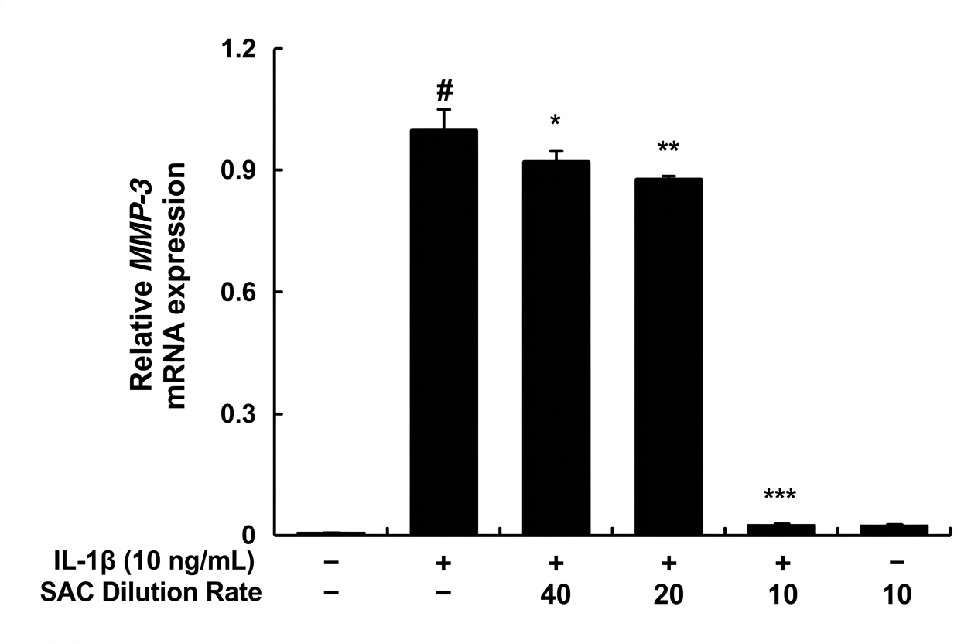
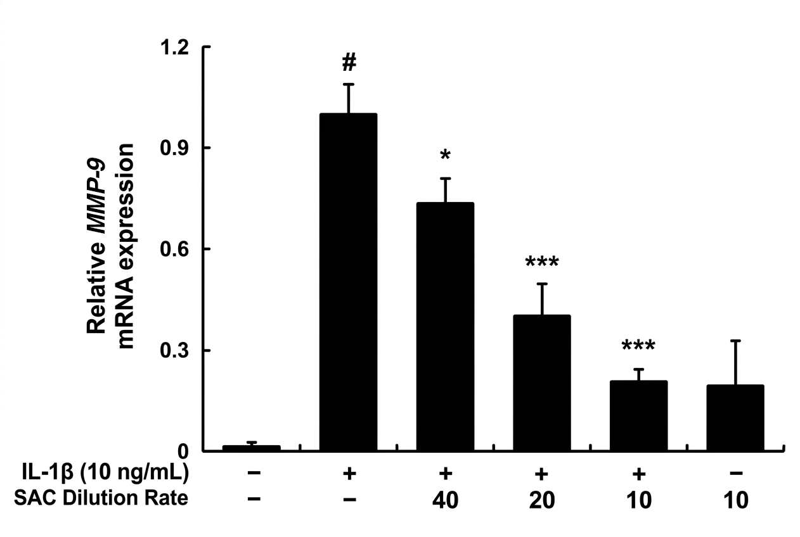
Effect of SAC on IL-1β-induced MMP-1, -3, and -9
mRNA Expression in hGF-1 Cells
Diluted in culture medium
A concentration-dependent decrease in MMP levels was observed following IL-1β induction compared to the CON

Slide 8
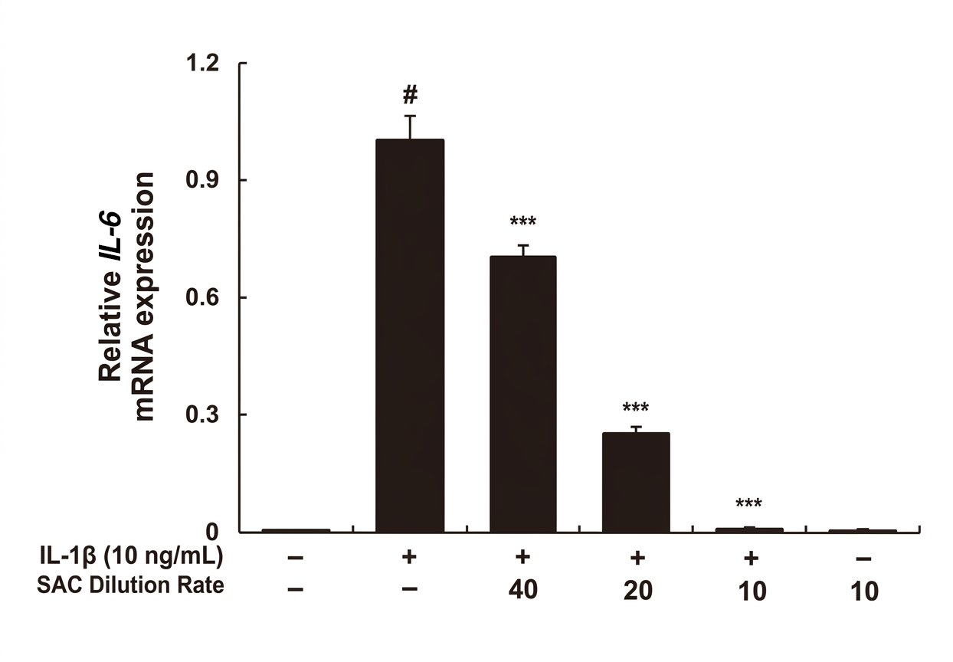
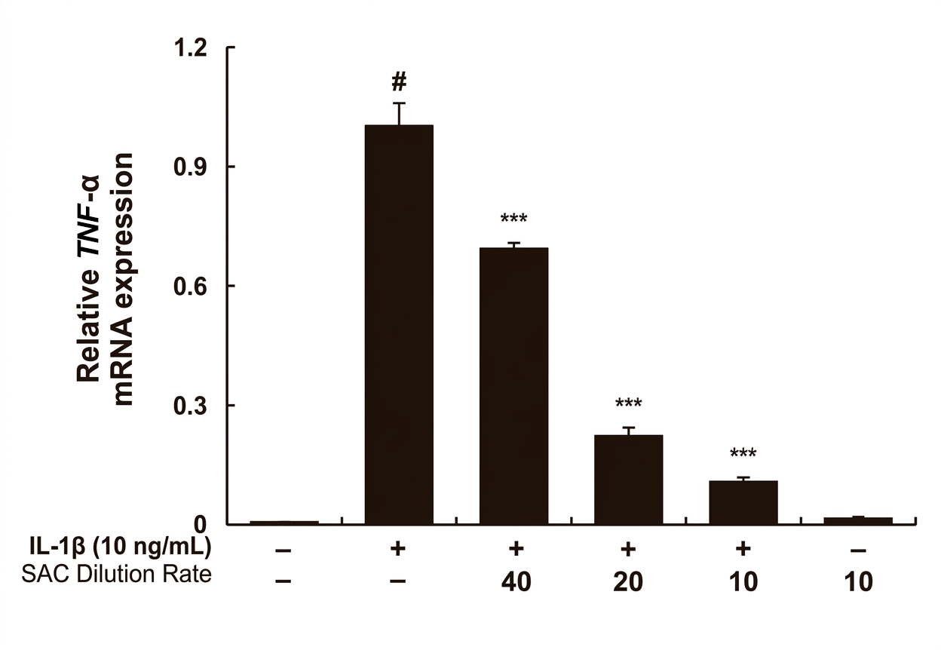
Effect of SAC on IL-1β-induced IL-6 and TNFα mRNA Expression in hGF-1 Cells
Diluted in culture medium
A concentration-dependent decrease in cytokine levels was observed following IL-1β induction compared to the CON

Slide 9
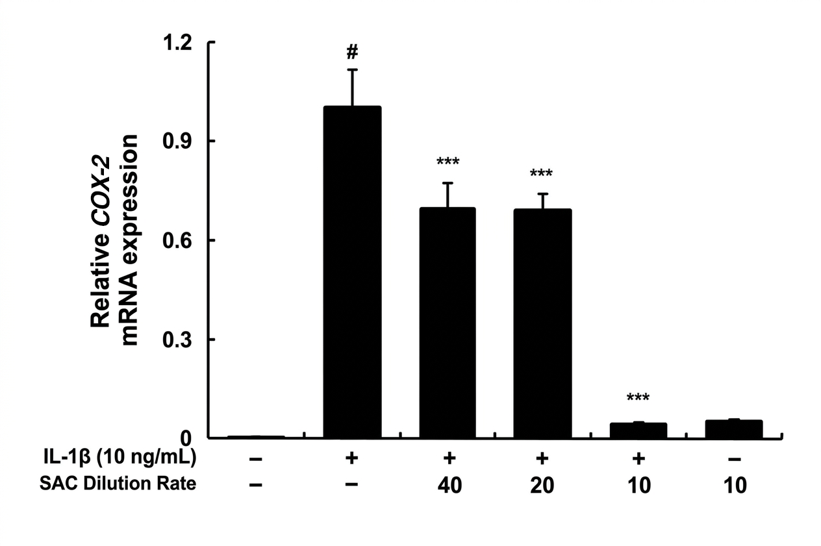
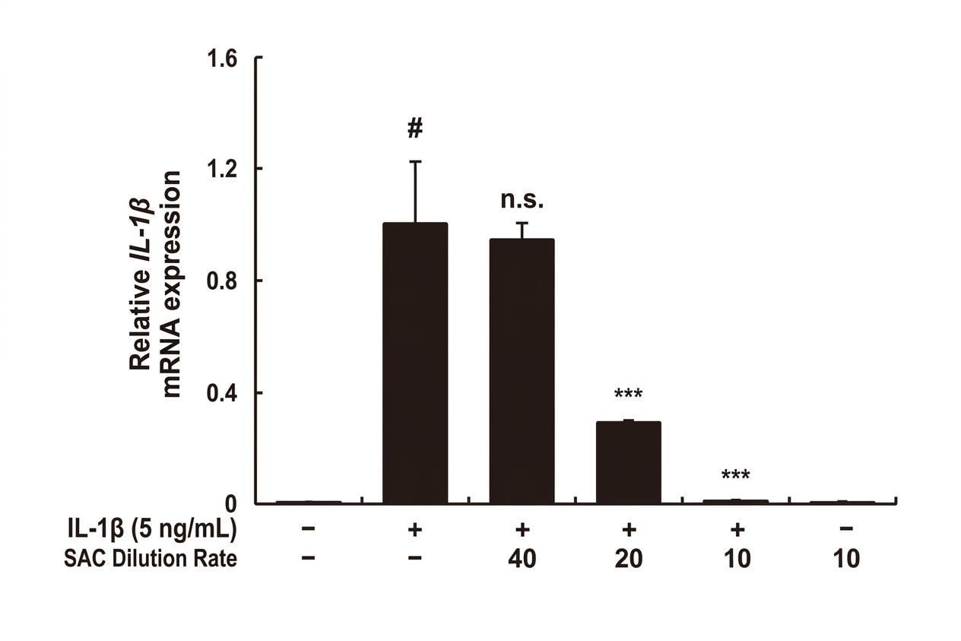
Effect of SAC on IL-1β-induced COX-2
and IL-1β mRNA Expression in hGF-1 Cell
Diluted in culture medium
A concentration-dependent decrease in cytokine and COX-2 mRNA expression was observed
following IL-1β induction compared to the CON

